Slide 1
Chapter 6: Creational Design Patterns
Session I: Overview of Design Patterns,
Abstract Factory

Slide 2
Session’s Agenda
Patterns in Detailed Design
  Again, Architectural vs. Design Patterns.
Classification of Design Patterns
  Purpose
  Scope
Documenting Design Patterns
Creational Design Patterns
  Abstract Factory
  Computer Store Example
What’s next…

Slide 3
Patterns in Detailed Design
In the previous sessions, the concept of patterns was introduced with an emphasis on software architecture.
  During detailed design, a wide variety of design patterns exist for providing solutions to recurring problems; these are documented by the GoF.
Remember, in 1994, Gamma, Helm, Johnson, and Vlissides—better known as the Gang of Four (GoF)—published their influential work that focused on a finer-grained set of object-oriented detailed design solutions that could be used in different problems “a million times over, without ever doing it the same way twice.”
  Influenced by Alexander’s work on architectural patterns, they called these Design Patterns.
  Their work resulted in the creation of a catalogue of 23 (detailed design) patterns.
  Each pattern was described in detail, using a specific pattern specification format.
Design patterns are recurring solutions to object-oriented design problems in a particular context.
  They are different than architectural patterns!

Slide 4
Patterns in Detailed Design
Architectural vs. Design Patterns
  Architectural patterns take place during the architecture activity of the software design phase; therefore, they serve best to identify the major components and interfaces of the system.
    Design Patterns take place during detailed design; therefore, they serve best to identify the inner structure of components identified during the architecture activity.
  Architectural patterns are too abstract to be translated directly to working code. Although they provide the general structure of the system, they do not fill the gaps required to create working code directly from the model.
    Design Patterns provided the details necessary for creating working code.
  Architectural patterns have a direct effect on the architecture of software and are associated with specific system types (e.g., interactive systems)
    Design Patterns have no direct effect on the architecture of systems and are independent of the type of systems. That is, a specific design pattern, e.g., the observer, can be used within every component specified by all architectural patterns.

Slide 5
Classification of Design Patterns
Design patterns can be classified based on:
  Purpose
  Scope
The purpose of a design pattern identifies the essence of the pattern; therefore, it serves as fundamental differentiation criterion between design patterns. The three types of purposes used for classification are:
  Creational
    Patterns that deal with creation of objects.
  Structural
    Patterns that deal with creation of structures form existing ones.
  Behavioral
    Patterns that deal with how classes interact, the variation of behavior, and the assignment of responsibility between objects.
The scope criterion captures whether a design pattern primarily applies to classes (during design time) or objects (during run-time).
  Although we will use the scope criterion when discussing specific design patterns, scope is not used much in practice. The dominant criterion for classifying (and talking about) pattern is the purpose criterion (i.e., creational, structural, and behavioral).

Slide 6
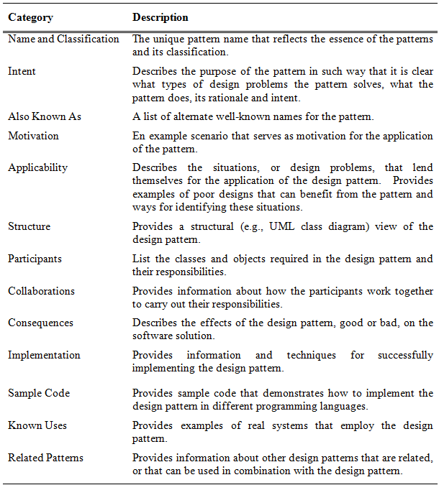
Documenting Design Patterns
Note:
The GoF identified 13 categories for documenting design patterns. Together, these categories provide detailed information of existing design patterns and provide direction for documenting future patterns.
Important:
In this course, we’re not concerned with presenting this extensive documentation for each pattern, so you won’t see this in future presentations of design patterns!

Slide 7
Creational Design Patterns
Creational design patterns abstract and control the way objects are created in software applications.
  They do so by specifying a common creational interface.
By controlling the creational process with a common interface, enforcing creational policies become easier, therefore giving systems the ability to create objects that share a common interface but vary widely in structure and behavior.
Examples of creational patterns include:
  The Abstract Factory
  The Factory Method
  The Builder
  The Prototype
  The Singleton

Slide 8
The Abstract Factory
The Abstract Factory is an object-creational design pattern intended to manage and encapsulate the creation of a set of objects that conceptually belong together and that represent a specific family of products.
According to the GoF [1], the intent of the Abstract Factory is to
  Provide an interface for creating families of related or dependent objects without specifying their concrete classes.
Like all creational patterns, Abstract Factory is composed of creator classes and product classes.
  As it will be seen, some creational patterns fuse the creator and product into one class.
  At first, the Abstract Factory may seem confusing because of the number of classes required, however, when you take a closer look at the pattern, you’ll see that the structural relationships required are modeled over and over the same way as new products are added to the design.

Slide 9
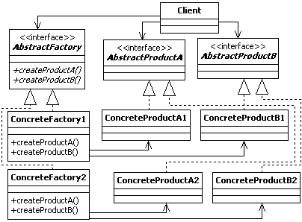
The Abstract Factory Design Pattern
Clients only know about creator and product interfaces! This allows us to vary behavior without changing client code!
Products need to obey the Product interface!
Factories need to obey the Factory interface!
Creator
Classes
Product
Classes
Important: Notice the Pattern!
Adding other products for existing families requires adding another AbstractProduct interface and concrete product classes!
Important: Notice the Pattern!
Adding a new family of products requires adding another Factory, AbstractProduct interface and concrete product classes!

Slide 10
The Abstract Factory Design Pattern
Important:
Adding a new family of products!
ConcreteFactory3
ConcreteProductA3
ConcreteProductB3
A New Family of Products has been added!
+createProductA()
+createProductB()

Slide 11
The Abstract Factory Design Pattern
Important:
Adding a new product to existing family of products!
A New Product has been added to existing families!
<<interface>>
AbstractProductC
+createProductC()
ConcreteProductC1
+createProductC()
ConcreteProductC2
ConcreteFactory3
ConcreteProductA3
ConcreteProductB3
ConcreteProductC3
+createProductA()
+createProductB()
+createProductC()

Slide 12
The Abstract Factory
— Very Simple and Fictional Example —
Consider a software system for a computer store, where the store carries only two types of computers for sale:
  Top of the line computer, we’ll call these advanced computers
  Inexpensive computers, we’ll call these standard computers
  Obviously, a computer store will need to carry more computers in the future!
Advanced computers are made up of “advanced computer products,” e.g. the latest multi-core CPU, wireless keyboard, advanced monitor (e.g., widescreen large 3D), advanced graphics & sound card, etc.
  For simplicity, we’ll only use CPU, keyboard, and Monitor for our example.
Standard computers are made up of “standard computer products,” e.g., single core CPU, wired keyboard, small screen monitor, low-grade graphics and sound, etc.
  For simplicity, we’ll only use CPU, keyboard, and Monitor for our example.
The system is designed so that it searches remote information sources, e.g. online websites, remote databases, etc. for product information, such as:
  Product reviews
  Customer’s comments from specific websites, e.g., Amazon.com
  Manufacturers’ comments
  …

Slide 13




The Abstract Factory
— Very Simple and Fictional Example —
Each computer is made up of different products
Information
Source
Information
Source
Information
Source
Information
Source
Customer
Computer Store
Information
Source
Information
Source
Information
Source
Each computer product is associated with one or more information sources. These sources are used to find out information about the product!

Slide 14
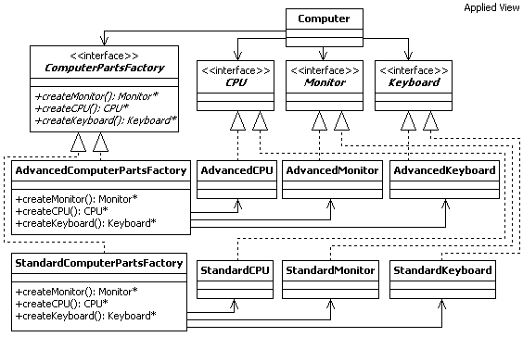
Abstract Factory for Computer Store
Creator
Classes
Product
Classes
Let’s break it down in the next slides…

Slide 15
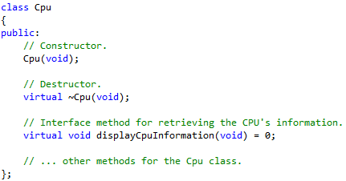
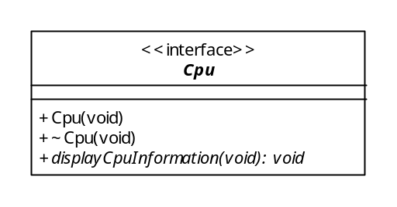
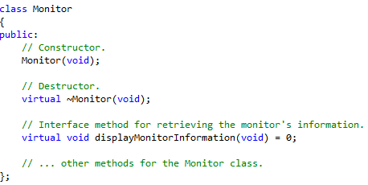
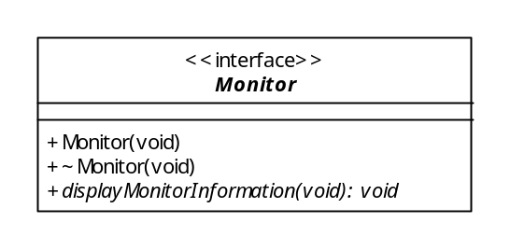
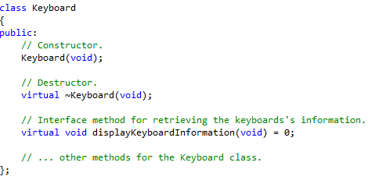
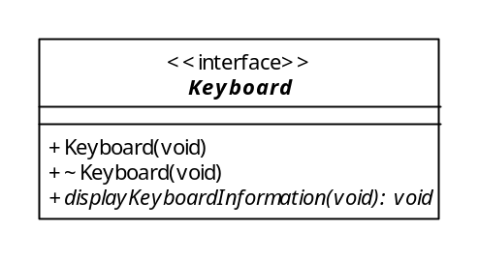
Notice how we create interfaces in C++
Notice the italics to denote the abstract method
This means that you cannot instantiate objects from this abstract class
Derived classes must provide implementation for this method before they can be instantiated!

Slide 16
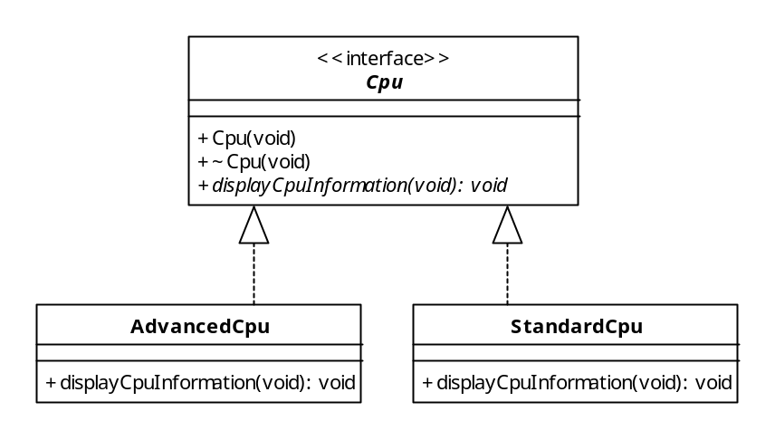
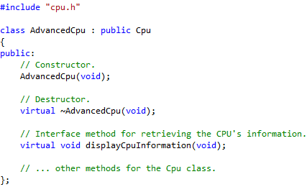
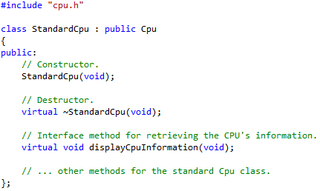
The Cpu Product Design

Slide 17
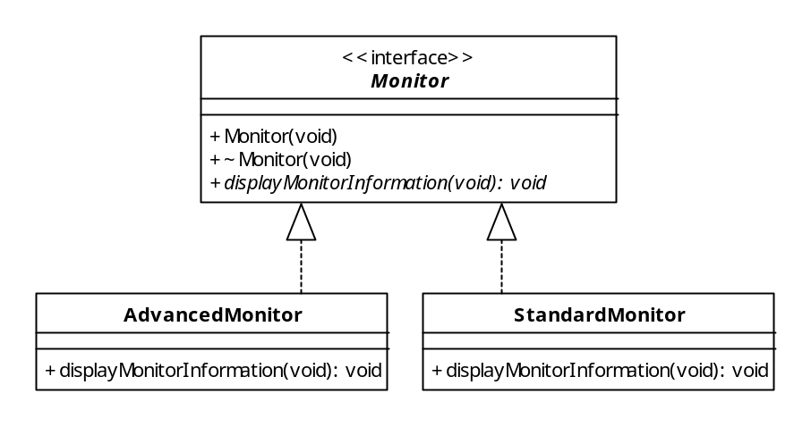
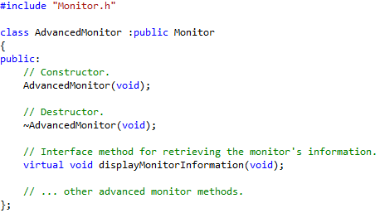
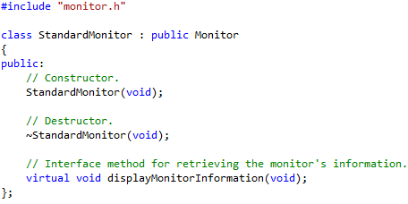
The Monitor Product Design

Slide 18
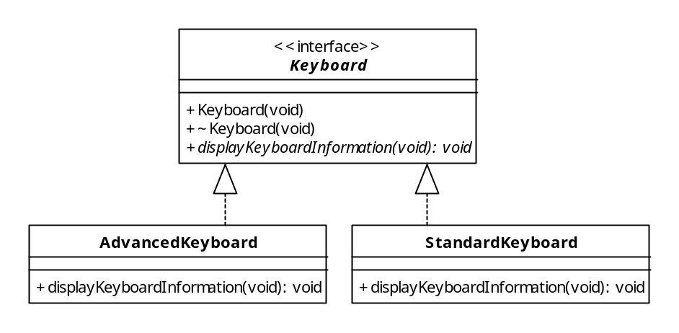
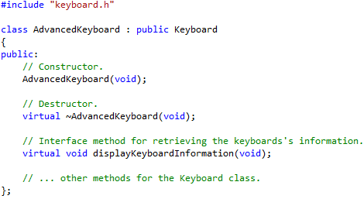

The Keyboard Product Design
Hopefully by this point you can start seeing the pattern for designing products!

Slide 19
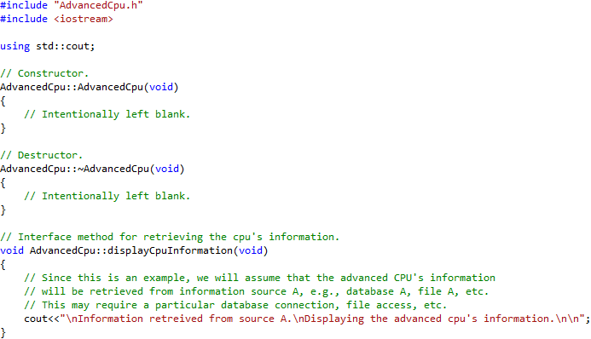
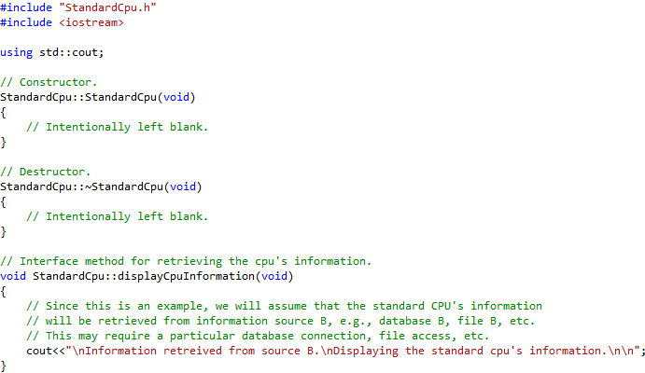
The Cpu Product Implementation
Information Source A
Database for
Advanced Products
The code in this function knows how to retrieve information from data source A, which can use specific format, location, etc.
File with
Information of
Advanced
Products
Information Source B
Database for
Standard Products
The code in this function knows how to retrieve information from data source B, which can use specific format, location, etc.
File with
Information of
Standard
Products

Slide 20
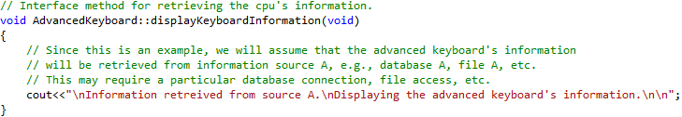
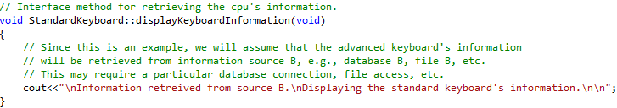
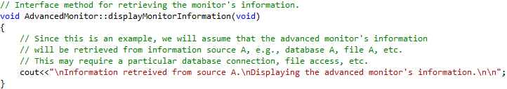
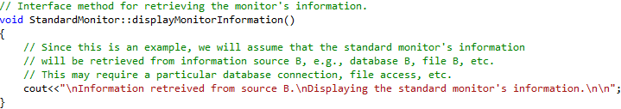
Other Product Implementation
All other products are implemented using the same pattern!

Slide 21
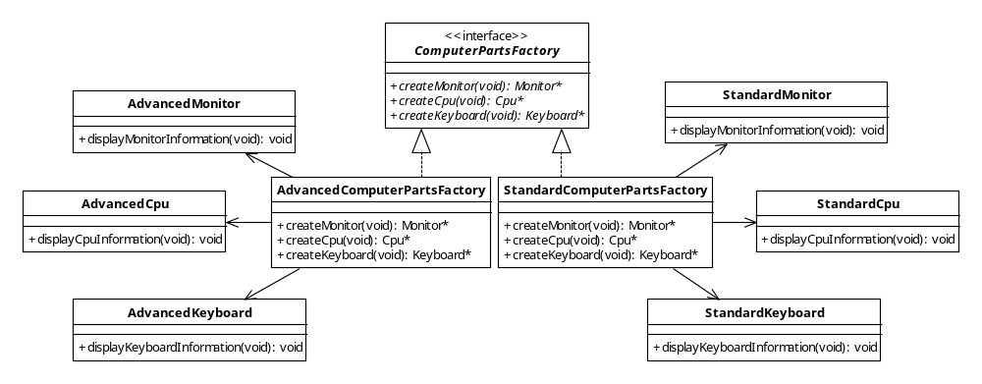
Design the Factory Interface and Concrete Factories
Important:
This design connects the products designed in the previous slides with the factories used to abstract their creation!

Slide 22
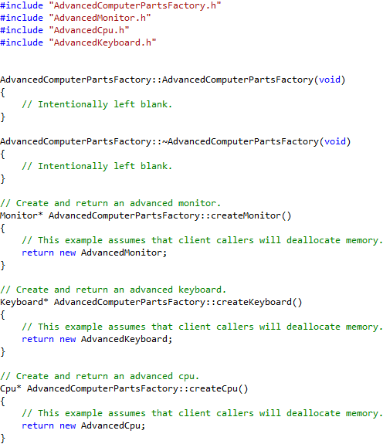
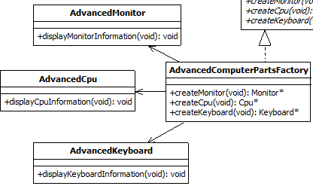
The Advanced Computer Parts Factory
These are equivalent!

Slide 23
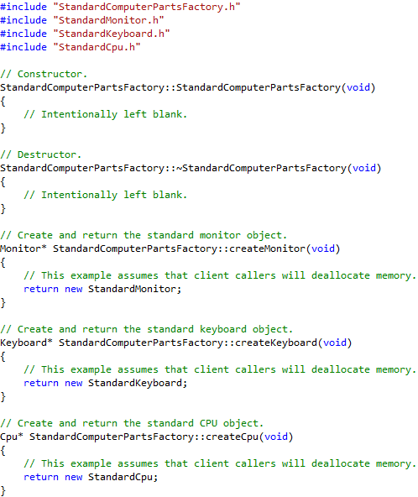
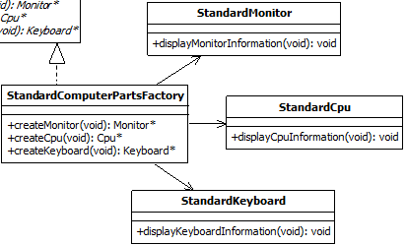
The Standard Computer Parts Factory
These are equivalent!

Slide 24
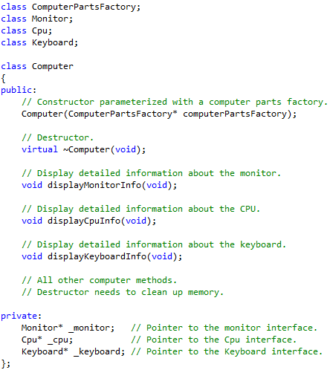
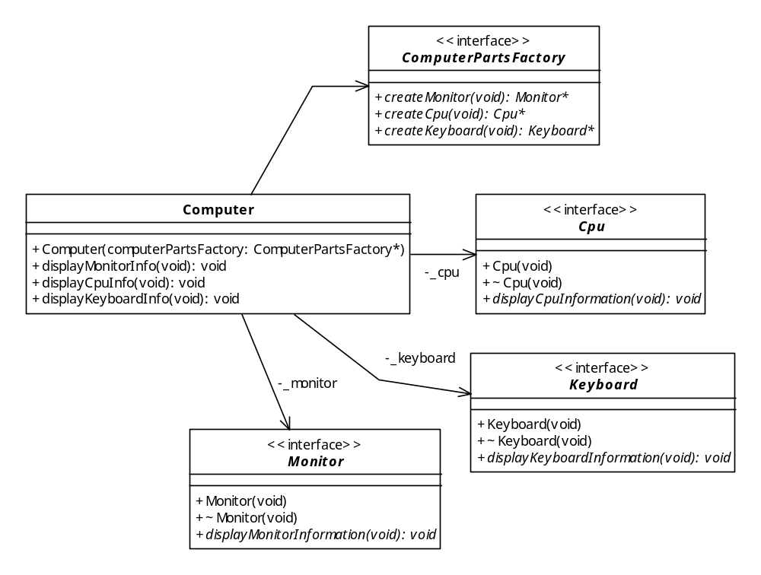
The Client Computer Design
These are equivalent!
Code from model!
Notice the named associations, which are specified with private visibility!

Slide 25
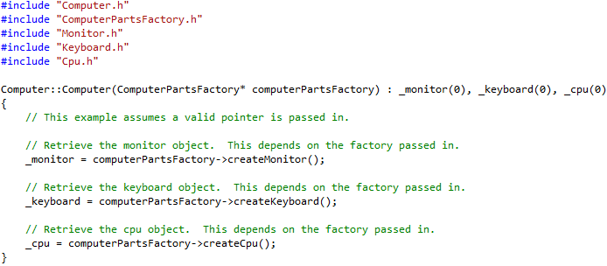
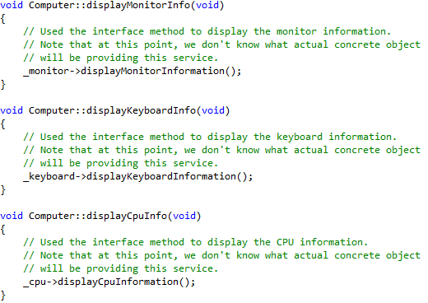
The Client Computer Design
If you want and advanced computer, pass in an AdvancedComputerFactory, otherwise, pass in a StandardComputerFactory
The Computer object is configured with a Factory object. The Computer object delegates creation of products to its Factory!
Since our design relies on interfaces only, this code works for both standard and advanced computers!

Slide 26
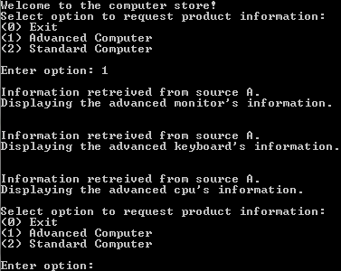
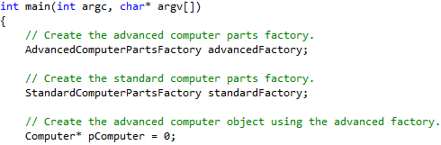
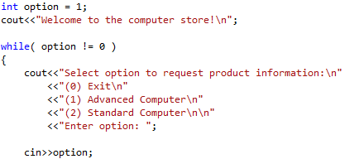
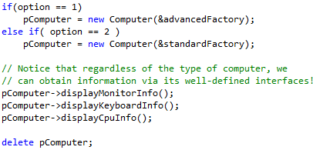
Abstract Factory Example – Putting it all Together
1
2
4
3
Notice how we configure the Computer object with a Factory object!

Slide 27
Abstract Factory Step-by-Step Summary
As seen, the Abstract Factory pattern can be used over and over to support new family of products or to add new products to existing ones. When designing with the Abstract Factory, execute the following steps:
  Design the product interfaces (e.g., Cpu, Monitor, and Keyboard)
  Identify the different families or groups required for the problem (e.g., standard vs. advanced computers)
  For each group identified in step 2, design concrete products that realize the respective product interfaces identified in step 1.
  Create the factory interface (e.g., ComputerPartsFactory). The factory interface contains n interface methods, one for each product interface identified in step 1.
  For each family or group identified in step 2, create concrete factories that realize the factory interface created in step 4.
  Associate each concrete factory from step 5 with their respective products from step 3.
  Create the Client (e.g., Computer) which is associated with both product and factory interfaces created in steps 1 and 4, respectively.

Slide 28
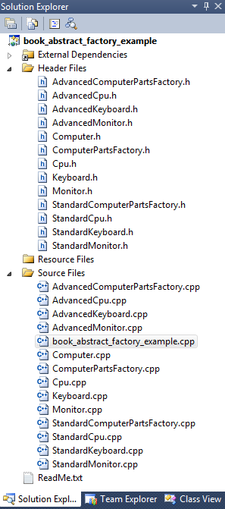
Consequences of Abstract Factory
Cons
  Large number of classes are required
Pros
  Isolates concrete product classes so that reusing them becomes easier
  Promotes consistency within specific product families.
  Adding new families of products require no modification to existing code.
    Additions are made through extension, therefore, obeying the OCP.
  Helps minimize the degree of complexity when changing the system to meet future needs.
    i.e., increases modifiability

Slide 29
What’s Next…
In this session, we presented fundamentals concepts of design patterns and creational design patterns, including:
  Abstract Factory
In the next sessions, we will continue the presentation on creational design patterns, including:
  Factory method
  Builder
  Prototype
  Singleton

Slide 30
References
[1] Gamma, Erich, Richard Helm, Ralph Johnson, and John Vlissides. Design Patterns: Elements of Reusable Object-Oriented Software. Boston: Addison-Wesley, 1995.

